Slide 1

Web Forms 2.0 Web storage Web SQL DB Geo Locations

Slide 2
HTML5-Web Forms 2.0
The <input> element in HTML-5
The <output> element
The placeholder attribute
The autofocus attribute

Slide 3
The <input> element in HTML5

Slide 4
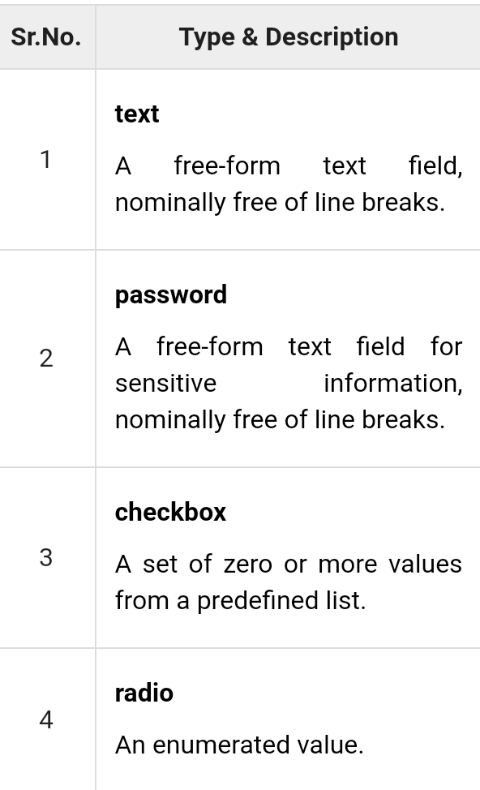
HTML4 input elements

Slide 5
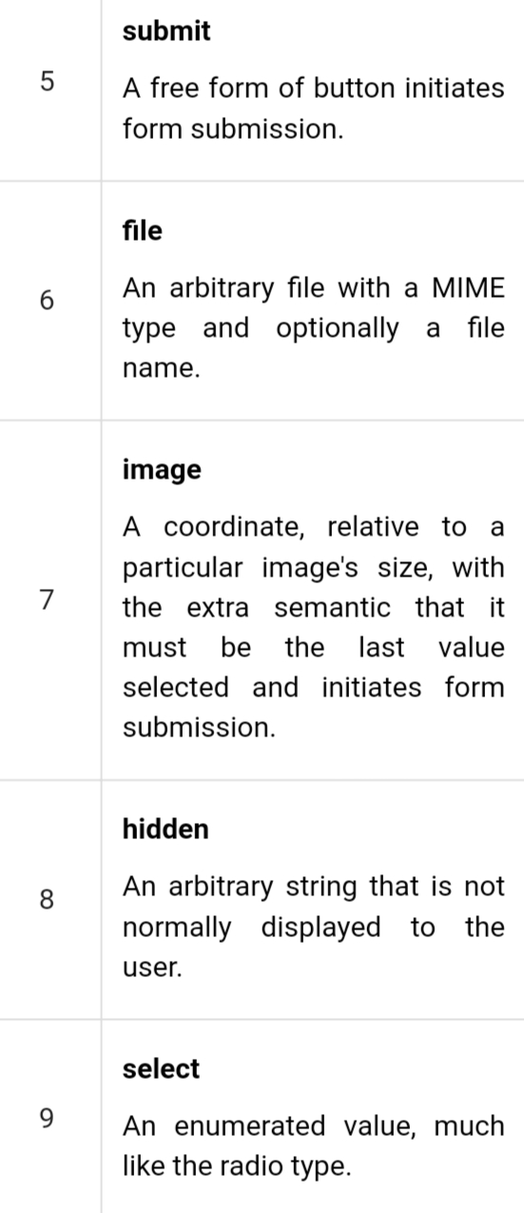

Slide 6
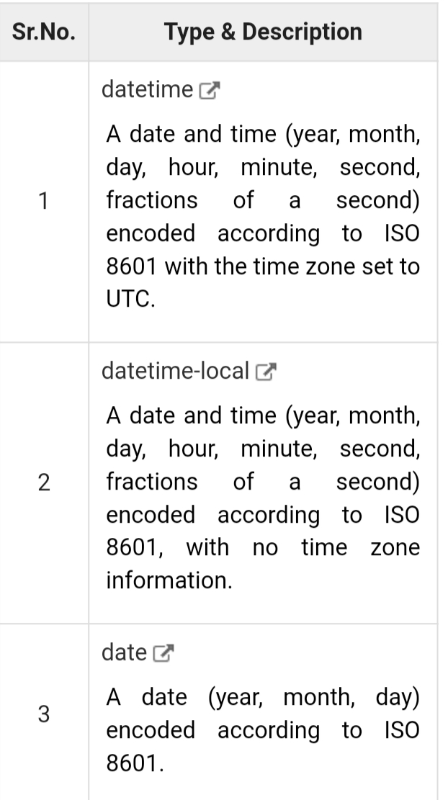
The <input> element in HTML5

Slide 7
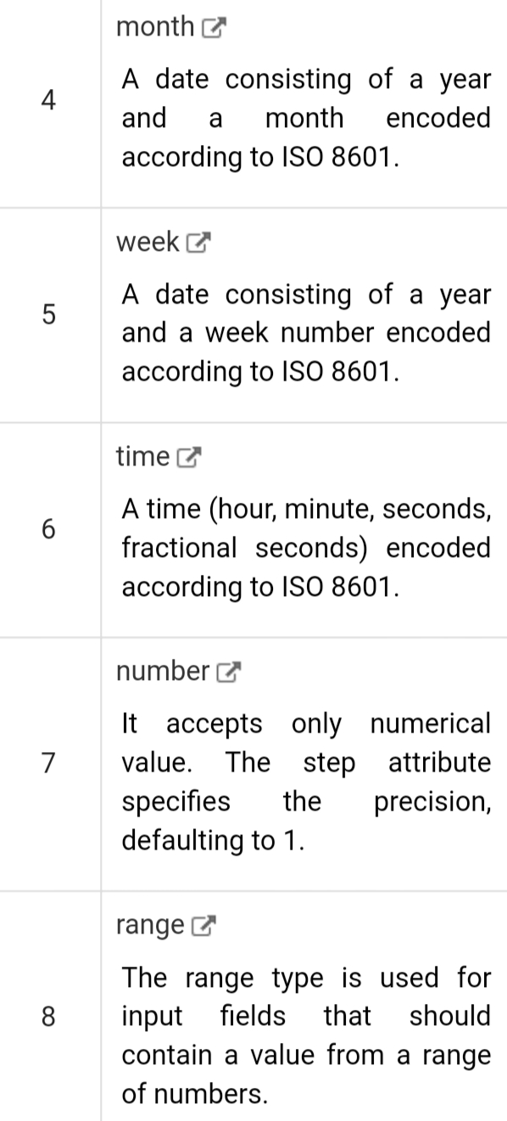

Slide 8
The <output> element
You can use the for attribute to specify a relationship between the output element and other elements in the document that affected the calculation (for example, as inputs or parameters).
The value of the for attribute is a space-separated list of IDs of other elements.

Slide 9
The placeholder attribute
HTML5 introduced a new attribute called placeholder.
This attribute on <input> and <textarea> elements provide a hint to the user of what can be entered in the field.

Slide 10
The autofocus attribute
This is a simple one-step pattern, easily programmed in JavaScript at the time of document load, automatically focus one particular form field.

Slide 11
HTML5 - Web Storage
Session Storage
Local Storage
Delete Web Storage

Slide 12
Session Storage
The Session Storage is designed for scenarios where the user is carrying out a single transaction, but could be carrying out multiple transactions in different windows at the same time.

Slide 13
Local Storage
The Local Storage is designed for storage that spans multiple windows, and lasts beyond the current session.
In particular, Web applications may wish to store megabytes of user data, such as entire user-authored documents or a user's mailbox, on the client side for performance reasons.

Slide 14
Delete Web Storage
Storing sensitive data on local machine could be dangerous and could leave a security hole.
The Session Storage Data would be deleted by the browsers immediately after the session gets terminated.
To clear a local storage setting you would need to call localStorage.remove('key'); where 'key' is the key of the value you want to remove.
If you want to clear all settings, you need to call localStorage.clear() method.

Slide 15
HTML5 - Web SQL Database
Opening Database
Transaction

Slide 16
Web SQL Database will work in latest version of Safari, Chrome and Opera.
The Web SQL Database API isn't actually part of the HTML5 specification but it is a separate specification which introduces a set of APIs to manipulate client-side databases using SQL
openDatabase − This method creates the database object either using existing database or creating new one.
transaction − This method gives us the ability to control a transaction and performing either commit or rollback based on the situation.
executeSql − This method is used to execute actual SQL query.

Slide 17
Opening Database
The openDatabase method takes care of opening a database if it already exists, this method will create it if it already does not exist.
To execute a query you use the database.transaction() function. This function needs a single argument, which is a function that takes care of
To create enteries into the table we add simple SQL query
To read already existing records we use a callback to capture the results

Slide 18
HTML5 - Geolocation
Geolocation Methods
Location Properties
Handling Errors
Position Options

Slide 19
The geolocation object is a service object that allows widgets to retrieve information about the geographic location of the device.

Slide 20
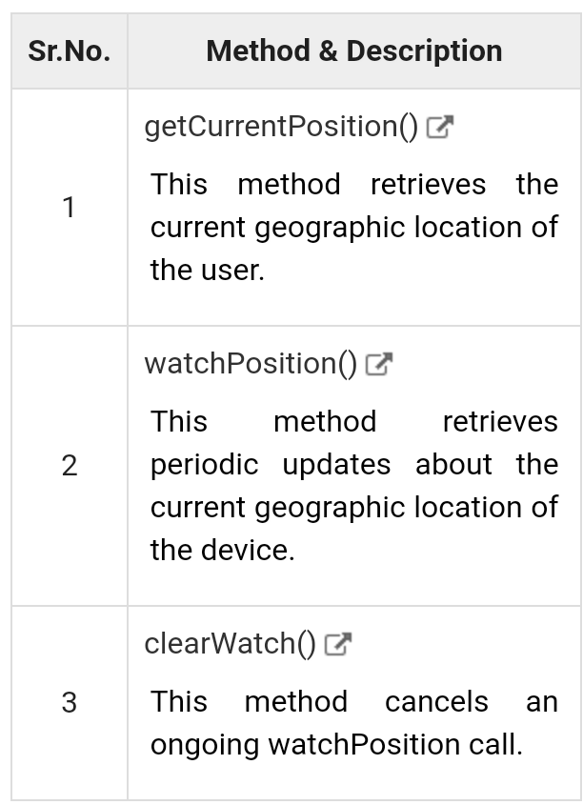
Geolocation Methods

Slide 21
Location Properties
Geolocation methods getCurrentPosition() and getPositionUsingMethodName() specify the callback method that retrieves the location information.
These methods are called asynchronously with an object Position which stores the complete location information.
The Position object specifies the current geographic location of the device

Slide 22
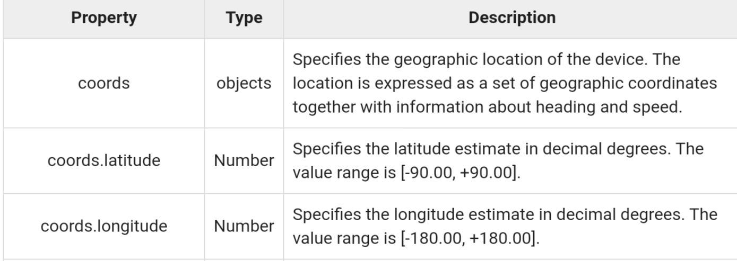
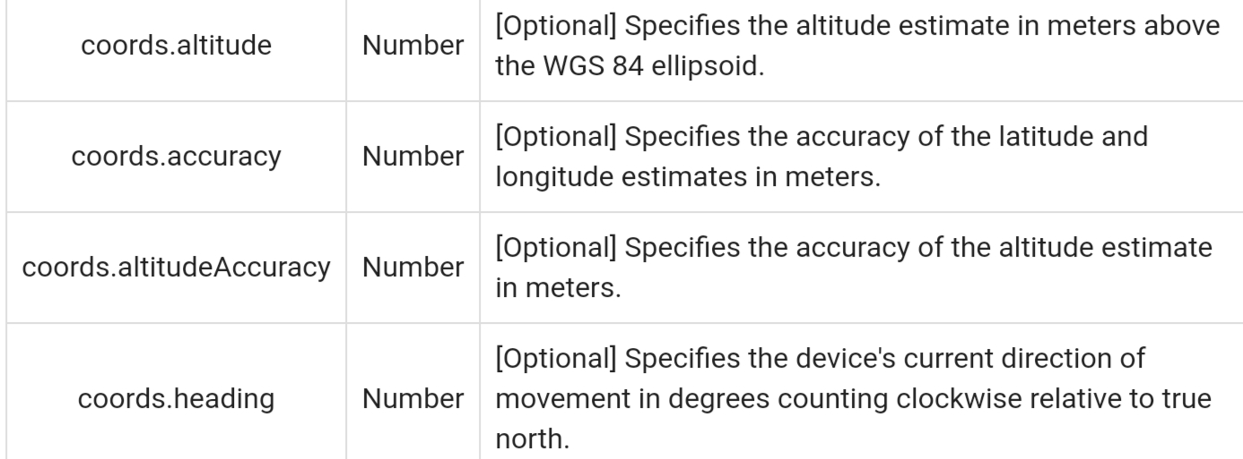

Slide 23
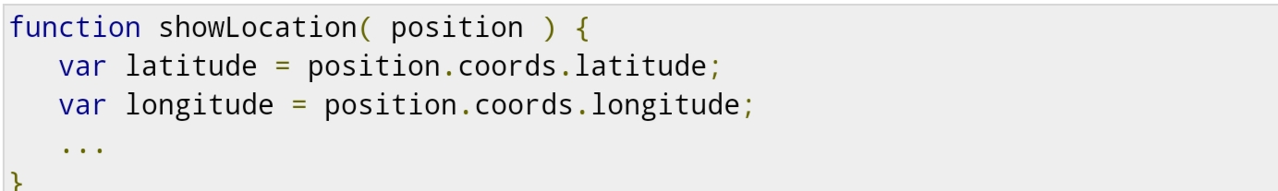
Example

Slide 24
Handling Errors
Geolocation is complicated, and it is very much required to catch any error and handle it gracefully.
The geolocations methods getCurrentPosition() and watchPosition() make use of an error handler callback method which gives PositionError object.

Slide 25
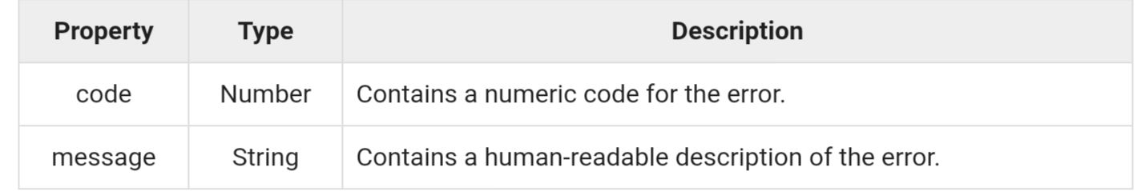
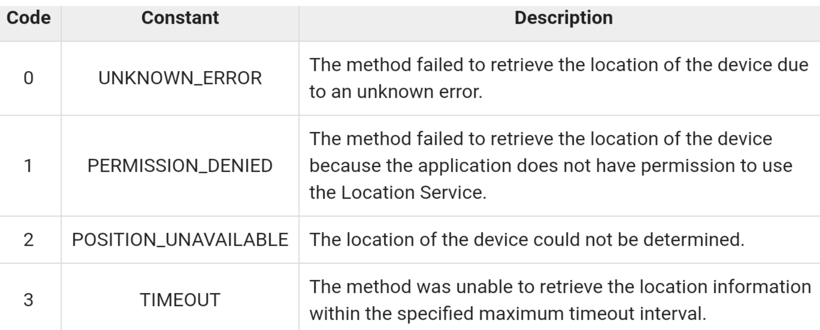

Slide 26
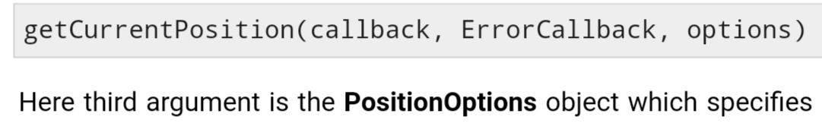

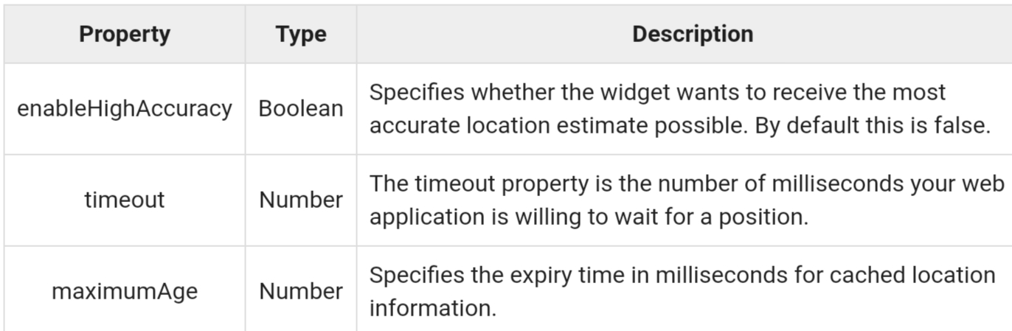
Position Options
Following is the actual syntax of getCurrentPosition() method

Slide 27


